Slide 1
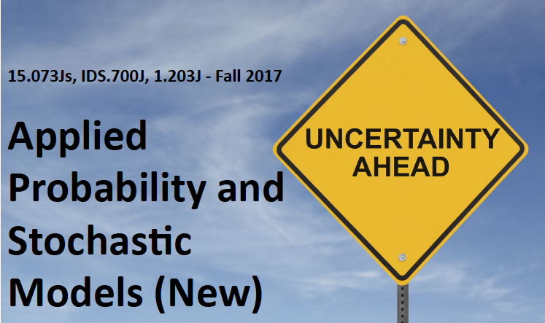
Geometrical Probability I
Richard C. Larson
Massachusetts Institute of Technology
September 27, 2017

Slide 2
In analyzing a Probability Problem, Remember Four Steps to Happiness
1. Define the Random Variables
2. Identify the joint sample space
3. Determine the probability law over the sample space
4. Carefully work in the sample space to answer any question of interest
4a. Derive the CDF of the R.V. of interest, working
in the original sample space whose probability
law you know
4b Take the derivative to obtain the desired PDF

Slide 3

Another Tip
A superlative
‘probability athlete’
knows the importance of good conditioning!
That will allow you to perform even more difficult exercises in probability!

Slide 4
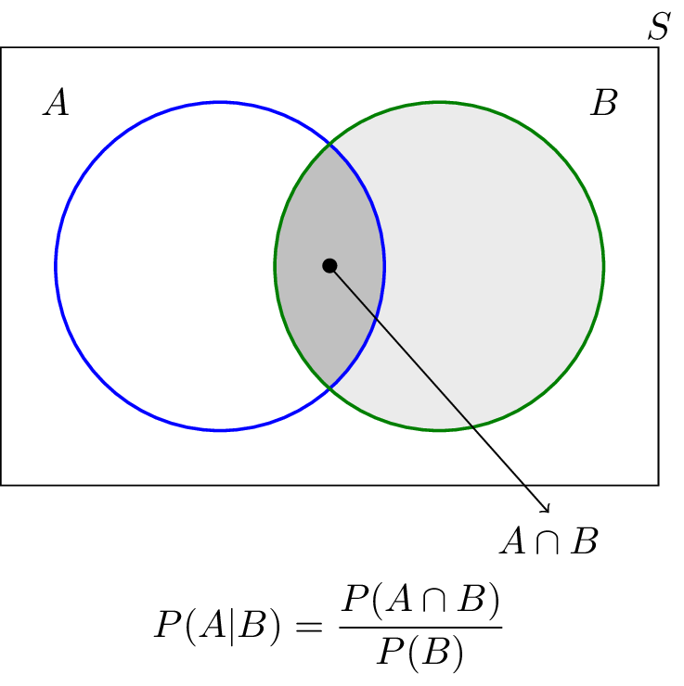
Let’s Talk About Conditional Probability
What is it?
Does it come on various flavors?
How to link to our sample space ideas?

Slide 5
Let’s Talk about PDF’s and PMF’s
Can you define each one in terms of a probability statement?
How to plot?
How to plot CDF’s of each?
What if you have a mixed random variable, part continuous and part discrete?

Slide 6
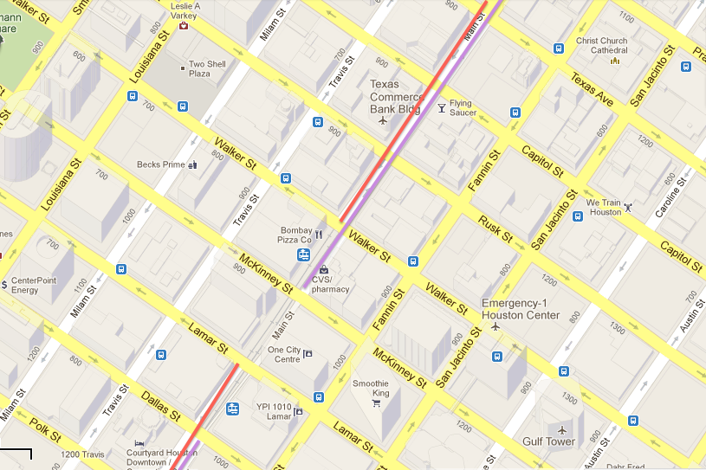
Back to One-Way Grid of Streets
Did you think about it?

Slide 7
With Probability 1/4, car on W-E street, & D = 0.
With Probability 1/4, car on S-N street, & D = 0.
Long Haul Direction

Slide 8
With Probability 1/4, car on W-E street, & D = 0.
With Probability 1/4, car on S-N street, & D = 0.
With Probability 1/4, car on E-W street, & D=.5(1)+.5(3)=2.
With Probability 1/4, car on N-S street, & D=.5(1)+.5(3)=2.
Long Haul Direction

Slide 9
With Probability 1/4, car on W-E street, & D = 0.
With Probability 1/4, car on S-N street, & D = 0.
With Probability 1/4, car on E-W street, & D=.5(1)+.5(3)=2.
With Probability 1/4, car on N-S street, & D=.5(1)+.5(3)=2.
So, mean extra distance traveled to get oriented for
long haul = (1/2)2 = 1 block length.
Long Haul Direction
What about cdf or
pdf of extra distance
traveled?

Slide 10
Geometrical Probability Interpretation of PDF’s
Draw any arbitrary pdf.
The region under the pdf can be considered to be the joint sample space for Random Variables X and Y, uniformly distributed under the pdf.
y
f_{X}(x)
x

Slide 11
Geometrical Probability Interpretation of PDF’s
Area of the sample space is one, so height of the pdf is one.
So, we are ‘throwing darts’ at the blackboard drawing of the pdf, counting only those under the pdf, and taking only the x value.
y
f_{X}(x)
x

Slide 12
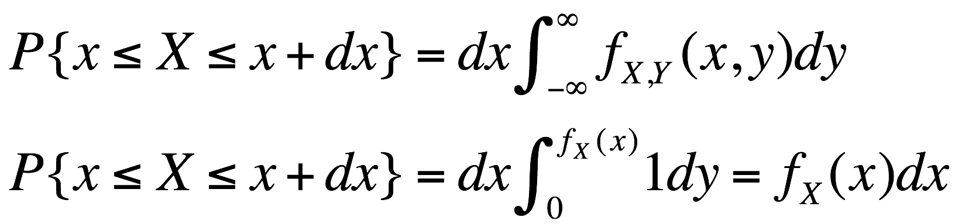
Geometrical Probability Interpretation of PDF’s
Check:
y
f_{X}(x)
dx
x

Slide 13
Example: Triangular Service Area
Customers uniformly distributed over triangular service area, L₁ distance metric
y
b
Facility
a
x

Slide 14
Example: Triangular Service Area
Customers uniformly distributed over triangular service area, L₁ distance metric
y
b
f_{X}(x)
2/a
x
a
a
x
f_{Y}(y)
Facility
2/b
b
y

Slide 15
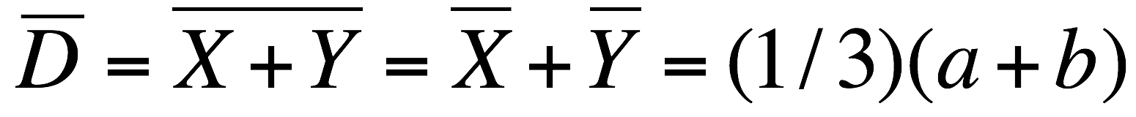
Example: Triangular Service Area
Customers uniformly distributed over triangular service area, L₁ distance metric
y
b
f_{X}(x)
2/a
x
a
a
x
f_{Y}(y)
Facility
2/b
b
y

Slide 16
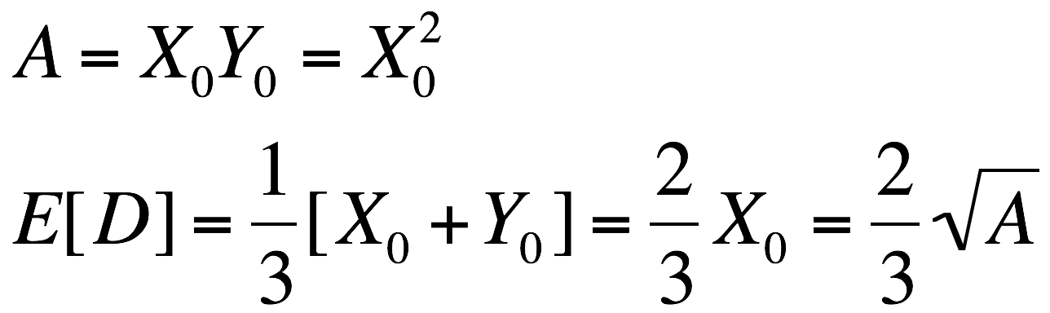
The Square Root Law, L₁ Metric
SQUARE:

Slide 17
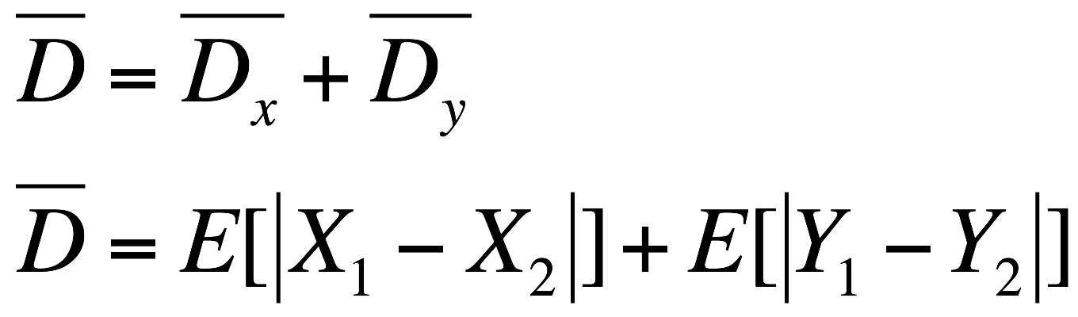
The Square Root Law, L₁ Metric
DIAMOND:
X₀
How do we do this?
(1) X and Y are symmetric.
Solve for one, get the other for free!
(2) “Divide & Conquer”
aka “Good Conditioning”
-X₀
X₀
-X₀
Note: Here, A=2(X₀)²

Slide 18
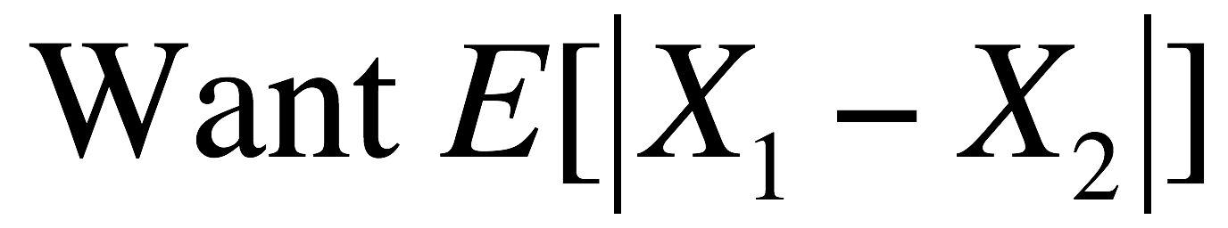
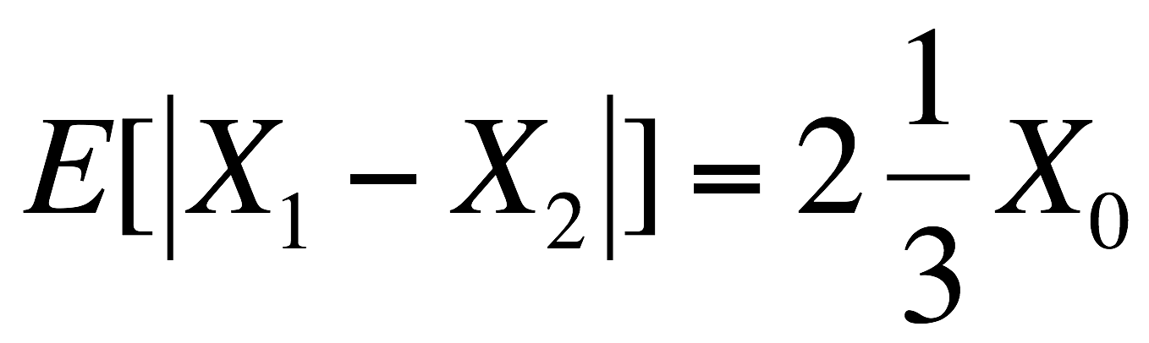

The Square Root Law, L₁ Metric
DIAMOND:
50% of the time, the 2 points are on
opposite sides of the y-axis. By inspection,
X₀
Why?
-X₀
X₀
-X₀

Slide 19
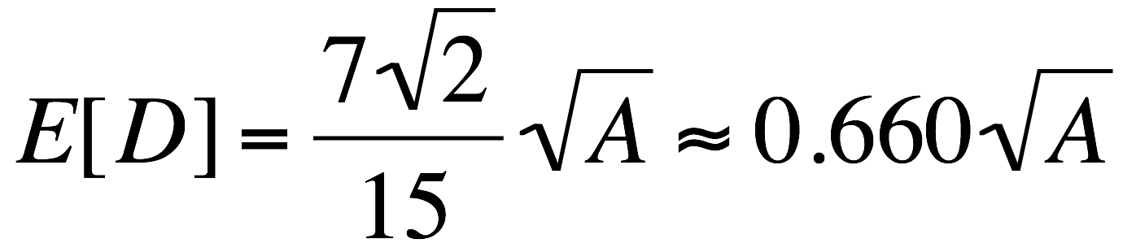
The Square Root Law, L₁ Metric
DIAMOND:
50% of the time, the 2 points are on
opposite sides of the y-axis. By inspection,
X₀
Why?
(ii) 50% of the time, the 2 points are on the
same side of the y-axis. Here we have the
absolute difference of 2 iid random variables
whose sample space is the square in the
positive quadrant. Same derivation as before
but with non-uniform pdf’s. A bit tedious in
calculus. See Pset #4.
-X₀
X₀
-X₀
Final Answer:

Slide 20
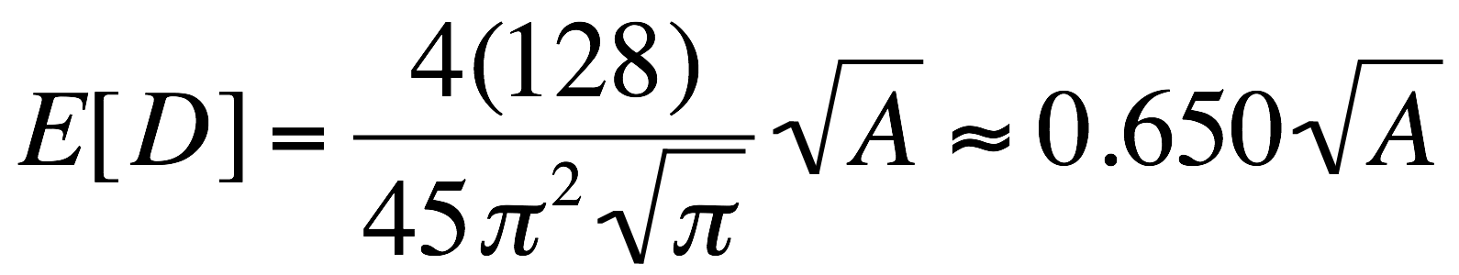
The Square Root Law, L₁ Metric
CIRCLE:

Slide 21
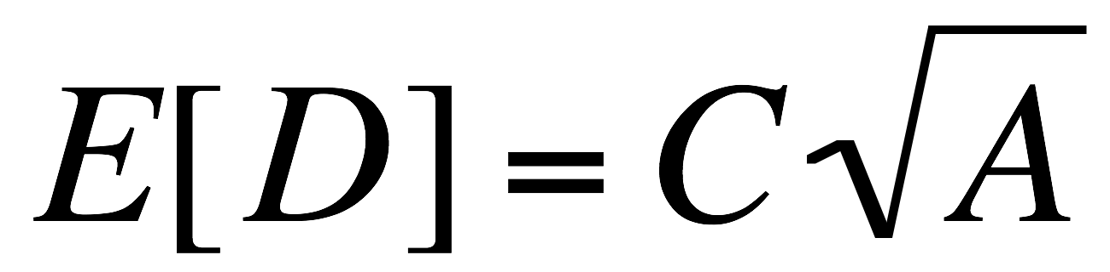
The Square Root Law
For a given “District Geometry,” Travel Distance Metric and Vehicle Positioning Scheme, we can write
where A is the area of the district and C is a constant depending on all 3 factors. We will investigate the C values and find that they are fairly insensitive to district shape!

Slide 22
Square Root Law Table
Distance Metric | Square | Diamond | Circle | Approximation
Euclidean, Random Location | 0.52 | .052 | 0.511 | .052
L_{1,} Random Location | 2/3 = 0.667 | 0.660 | 0.65 | 0.67
 |  |  |  | 25% reduction with fixed loc.
Euclidean, Fixed Location | 0.383 | 0.383 | (2/3*π^{[1/2]}) = 0.376 | 0.38
L_{1 ,} Fixed Location | ½ = 0.5 | 2^{(1/2)}/3=0.471 | 0.479 | 0.5

Slide 23
Divide & Conquer by
Good Conditioning
Situation: You have a complex geometry and and operation of mobile units. You wish to use “engineering approximations” to estimate the operational performance characteristics of the system. Some call this “back-of-the-envelope” analyses.

Slide 24
Divide & Conquer by
Good Conditioning
Step 1: Divide District R into several (possibly many) non-overlapping zones. Each zone should have the following properties:
  (a) Shape is a square, diamond, circle or some other easy-to-work-with shape.
  (b) The pdf for the spatial distribution of incidents within each zone must be approximately uniform.

Slide 25
Divide & Conquer by
Good Conditioning
Step 2: Using our techniques, compute all intra-zone and zone-to-response unit expected travel distances as required by the stated problem.

Slide 26
Divide & Conquer by
Good Conditioning
Step 3: Multiply the conditional expected distances in Step 2 by the appropriate conditional probabilities, and sum to obtain the overall expected travel distances for District R.

Slide 27
Coverage
Coverage vs. mean response time. Fire departments and pizza delivery services seem to be more interested in coverage: The fraction of customers that can reach in n minutes. Not so much mean response time. Why?

Slide 28
Coverage
Coverage: A point x is ‘covered’ if at least one response unit is within a “coverage distance” d of the incident. OR location literature….
Let X = set of points in [0, 1] that are covered.
μ(X)= “length” of set X.
Draw a picture. Note that more than one response unit may be covering a point x.
Ambulance example on blackboard.
Note law of diminishing returns.

Slide 29
Random Triangles
Here we will consider “Poisson field” of straight lines. http://bit.ly/RNMvfv

Slide 30
With Probability 1.0,
Any Three Lines Create a Random Triangle

Slide 31
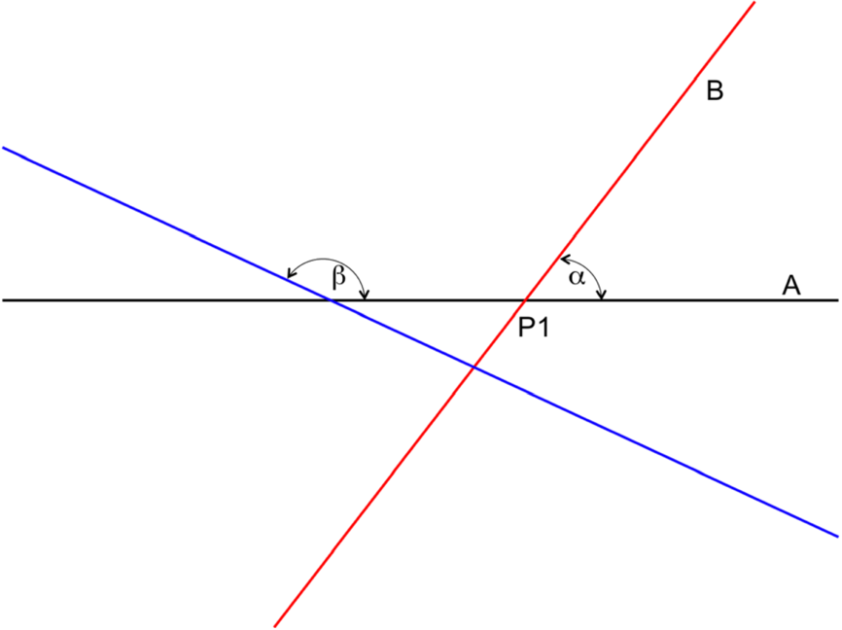
Three Random Lines from Poisson Field Crossing:
Acute or Obtuse?
P2
Assume: β and α and independent, uniformly distributed over {0, π].
We seek: The probability that the three lines will create an obtuse triangle.
Shown here: Case 1: β > α. Then the triangle formed by the 3 lines lies
below A, as shown in the figure, and the angles of the triangle are α, π− β, β − α.
If the triangle is obtuse, then one of these angles must exceed π/2. See Figure!

Slide 32
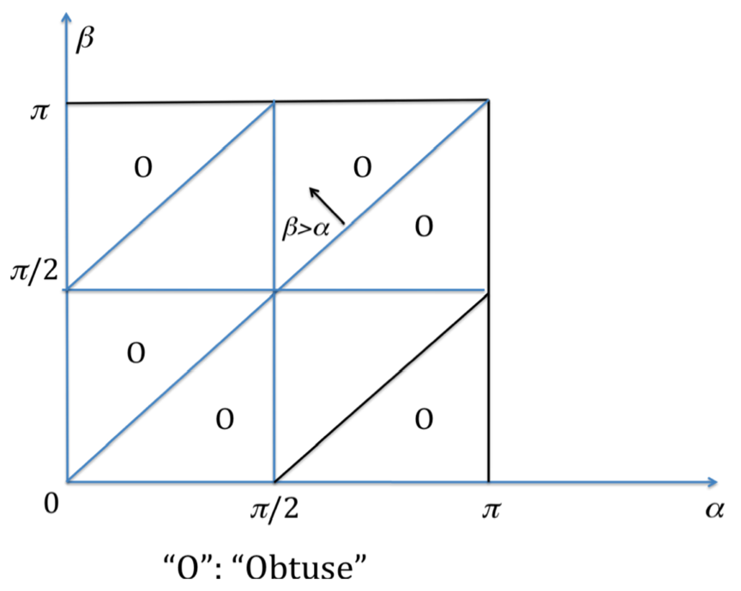
β>α+π/2
α>π/2
Pr{Acute}=1/4
A
β<π/2
A
“A”: “Acute”

Slide 33
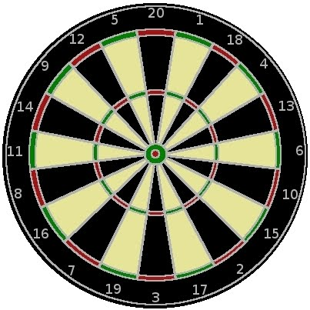
That’s All for Today, Folks!

